Slide 1

Using the expertise of academics and academic research to change police practice:
Operation Soteria Bluestone and The National Operating Model for Rape and Serious Sexual Offences
Professor Betsy Stanko OBE
30 November 2023

Slide 2

Police-Academic Collaborations
Different worlds
Managing trust
Timing and rigour of academic analysis
Managing secrecy and offering insight
Craft and science meets as equal knowledge

Slide 3
Why collaborate?
Policing matters: Impact on survivors’ lives can be life changing
Police can stop the perpetrators – many survivors report so that another will be spared
Policing intersects with vulnerability, race/ethnicity and disability with feeding inequalities
Getting the basics of police response matter does make a difference to victims-survivors
Hohl et al. (2023) Rape and sexual assault survivors’ experience of the police in England and Wales, published 21 September 2023

Slide 4

The Operation Soteria approach
Theoretical framework: the pillars (Hohl and Stanko, 2022, 2024)
Rigorous empirical research: the “deep-dives”
Genuine collaborative working between academics, police forces, the wider policing landscape and the third sector
Home Office funded: £6.65 million to date

Slide 5
Theoretical framework
(Hohl and Stanko, 2022)
Suspect focused investigations
Repeat suspects
Procedural Justice approach to victim engagement
Learning, development and officer well-being
Data and performance
Digital Forensics
5

Slide 6
The detail of research and its translation into practice
Knowing your justice business: using social science methods to explore problems through the expertise of academic expert on sexual violence 233 case file reviews (police internal peer review based on academic coding frame and training) 741 outcomes 14, 15 & 16 case file reviews
Notes:
BETSY
Academic methodology, applied social science, looking to establish the evidence that exists within;
Hear the experiences of your front line and supervisors
Delve deeply into routine records to find patterns, understandings and meaning to shape better ways of working and decision making
Insist on the academic rigour for learning and development
This project’s evidence is solely from the deep dives – and the most extensive project we know about to date globally

Slide 7
Social science multi-methods contributed to a rounded understanding of the context of decision-making Hundreds of hours of observations of RASSO shifts, ABE interviews, and body worn video footage Review of training courses in all pathfinder forces Police officer survey on well-being, learning and development Dozens of interviews and focus groups with officers of all ranks and roles, ISVAs, support service provides, CPS, lived experience panels Extensive document reviews of all force internal RASSO-related documents provided to us
The detail of research and its translation into practice
Notes:
BETSY
Academic methodology, applied social science, looking to establish the evidence that exists within;
Hear the experiences of your front line and supervisors
Delve deeply into routine records to find patterns, understandings and meaning to shape better ways of working and decision making
Insist on the academic rigour for learning and development
This project’s evidence is solely from the deep dives – and the most extensive project we know about to date globally

Slide 8
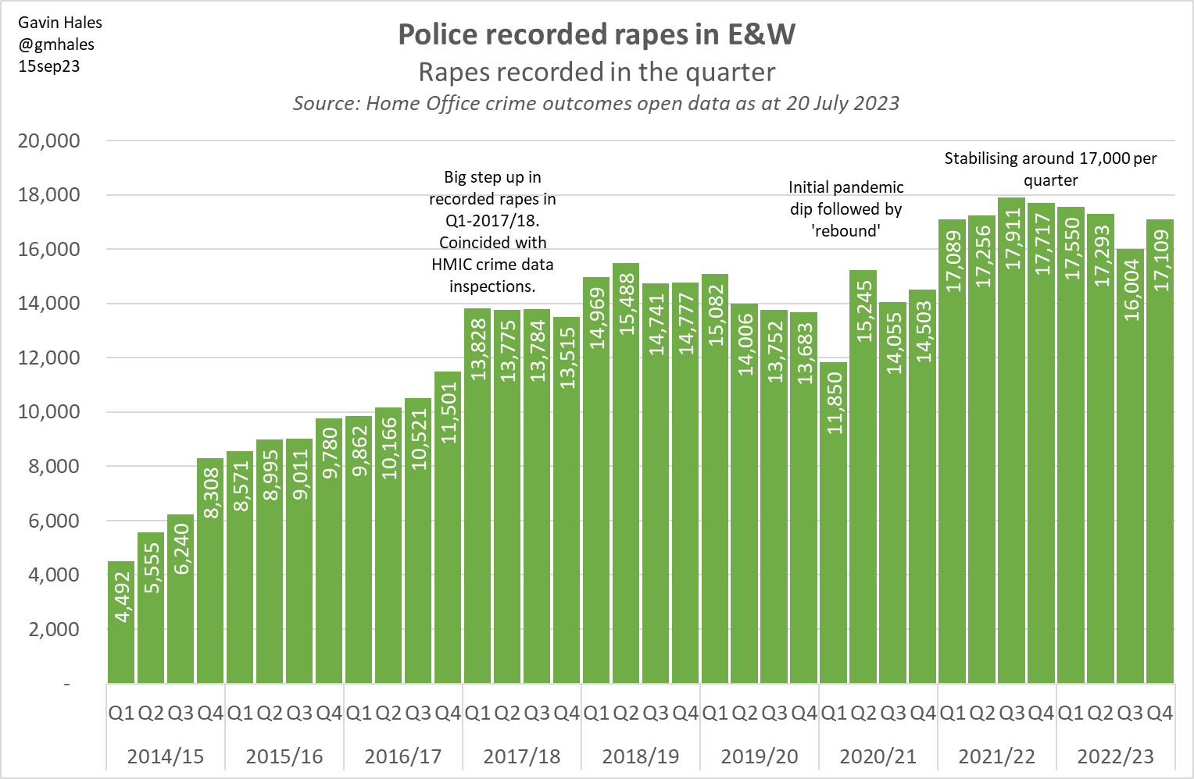
Official data tells the number of rapes recorded, not the context
Large increases (3.4x) in police recorded crime volumes to early 2018/19.
Then gradual falls before a clear drop in the first quarter of the pandemic, somewhat offset by an apparent ‘rebound’ in the subsequent quarter.
There was then a clear ‘step up’ in Q1 2021/22, and latterly a fall (seen in approximately 30 out of 43 forces for rape offences; also seen for some other offence types).
@gmhales

Slide 9
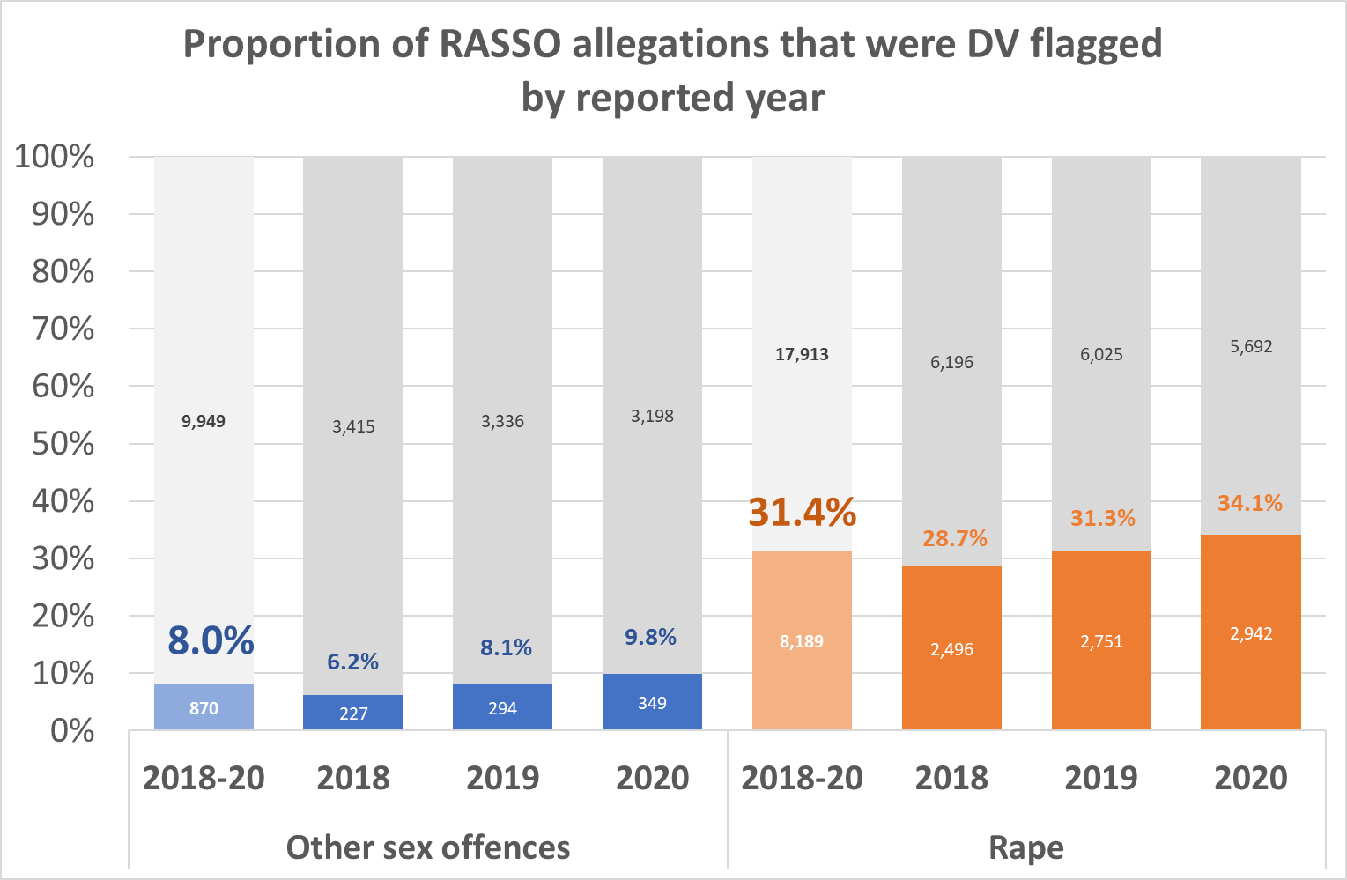
1 in 3 rape allegations and 1 in 12 other serious sexual offences are DA flagged/intimate partner
Notes:
By contrast, only c. 5% of rape allegation are ‘Stranger 1’ and 10% ‘Stranger 2’
The proportion of cases flagged as DA/DV has been increasing
Unclear if this reflects changing offending, reports or recording/flagging
We are told there has been an emphasis on data completion in the last 2-3 years.
Note the proportions reconcile quite well with the relationships data: Betsy, this is because DA includes family abuse, or even flatmates, and all sorts of domestic relationships, not just intimate partners. Ex and current partners, depending on force, back up around 70% of abuse. Inconsistency both because some DA is not intimate partner, but also clearly not all intimate partner is DA flagged (see rape figures).
1 in 3 rapes 2018-20:
31.4% DA/DV flagged
33.2% intimate/previous intimate relationship (see following slides)
1 in 12 other SSOs 2018-20:
8.0% DA/DV flagged
7.8% intimate/previous intimate relationship
2021 London Rape Review: 35% of rapes DA related
“17% of all rapes were reported in response to DASH questions”
Suggests around half of DA rapes were reported secondarily to primary allegations of other DA
Links to changing crime recording practices – an issue raised in both A&S and the Met

Slide 10
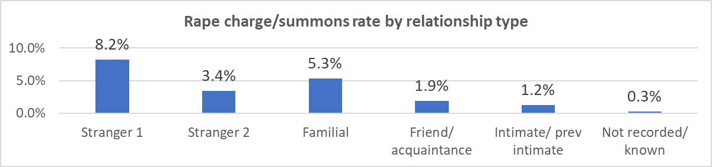
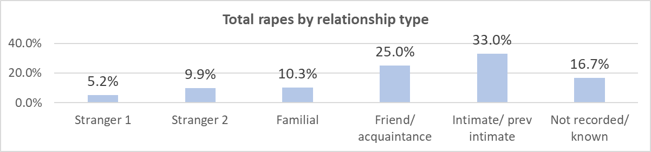
Suspect/victim relationship type is a key determinant of outcomes
Notes:
Police Problem Profiles and public discourse around rape and the responses to it tend to focus on stranger rapes, but in the Met data there were 2x as many rape allegations in the context of current and former intimate partners. 2/3rds were intimate, family or friend/acquaintance.
As in A&S, relationship type is a key determinant of outcomes.
In A&S, the charge rate for intimate/former intimate was 1.26% vs 1.23% in the Met;
Other familial: 5.2% A&S, 5.3% Met
‘Stranger’ was 4.3% in A&S, 5.1% in the Met (stranger 1 and 2 combined).
Stranger 1: consent generally not a factor, forensics key – almost all charges relate to reports made in the first week
“Where the offender has no prior contact with the victim or where there are brief comments/questions between victim and suspect (e.g. Do you have the time?).“
Stranger 2: “Victim and suspect are briefly known to one another, for example they had met at a party, club or bar, only spoke on the phone before or had a client/prostitute relationship. Includes minicabs, Internet approaches, and positions of trust (i.e. bogus authority figures).”

Slide 11

Collaborative solutions and professional trust
A leap of faith – for both sides
Joining forces to achieve a shared goal
Iterative, reflective – not linear
Academic knowledge, ‘craft’ and experience
Ongoing engagement

Slide 12
What we learned: corporate problems undermine investigative decision- making
Eco-structure of investigation enabled victim credibility to be the first and last port of call as ‘evidence’
Investigative curiosity about sexual offending was lacking
Corporate management neglected the high and stressful workloads of the investigators
Specialist learning and development about sexual victimization and sexual offending are non-existent
Poor analytics – from strategic overview to understand the problem and track progress in outcomes
At times, fractured and mal-aligned partnerships with third-sector support for victims

Slide 13
Collaborative solutions and other support
Police officers worked within their forces to use the learning and insight to change practices from within.
College of Policing acted to transform its offer for specialist learning and development for the police service.
The HMICFRS* will be inspecting forces to assess how forces use the approach.
*England and Wales’ assurance agency for policing

Slide 14

Academic insight into policing cultures
Understanding resistance to change
Researchers encountered “Three cultures”
  Hostile to outside intervention/disrespectful
  Receptive to new ideas and academic insight
  New Joiners (police recruits)
Toxic cultures are treacle

Slide 15
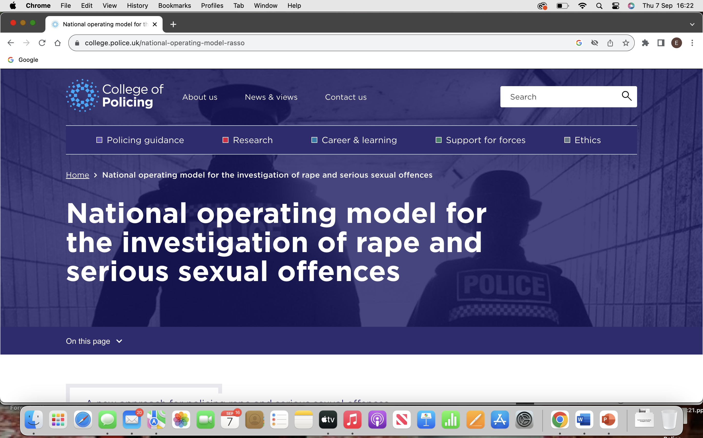

Slide 16









Vision
The flightdeck
Strategic layer
Operational layer
Foundational enablers

Slide 17
The NOM: a guide for investigation
Six words:
Victim Centred
Suspect Focused
Context Led

Slide 18
National Operating Model for the investigation of rape and sexual offences
Aim
Aim one – outcome justice for all victims
Aim
Aim two – procedural justice for all victims and all suspects
Aim
Aim three – reduction and prevention of RASSO

Slide 19
The journey has begun
A change in thinking: collaboration revealed the benefit of working together Policing can only drive whole system change; they needed fresh eyes to help them do so A moment of truth: nothing less than transformational change will do Culture is policing’s banana skin

Slide 20
Challenges ahead
Scalability and sustainability
Transparency, accountability and governance
End-to-end transformation of the justice process

